Slide 1
Chapter 2 Introduction to Java Applications

Slide 2
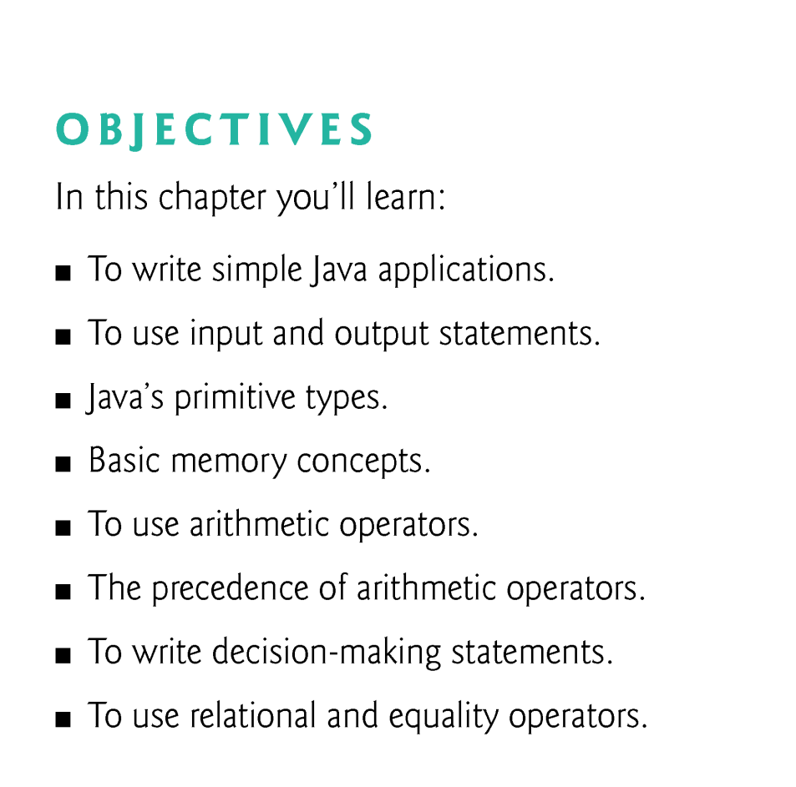

Slide 3
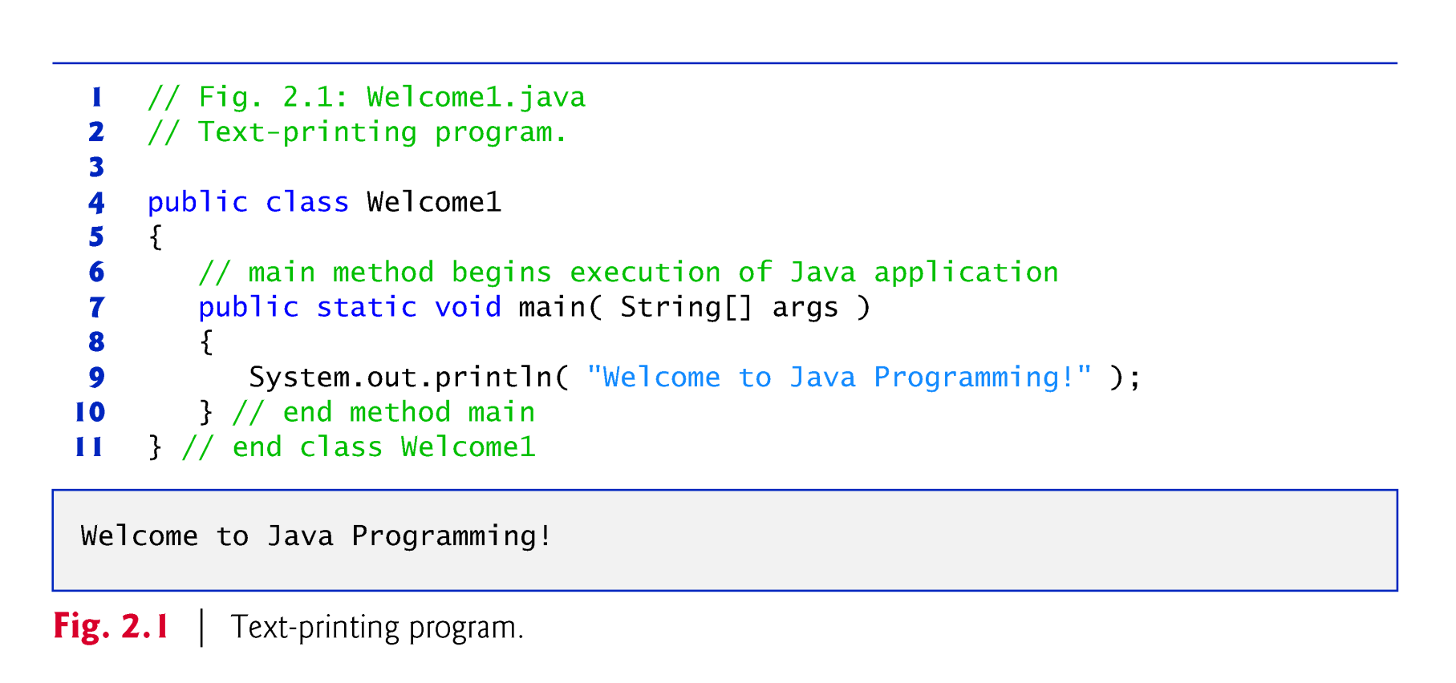
2.1 Our First Program in Java: Printing a Line of Text

Slide 4
2.2 Our First Program in Java: Printing a Line of Text (Cont.)
Comments
// Fig. 2.1: Welcome1.java
// indicates that the line is a comment.
Used to document programs and improve their readability.
Compiler ignores comments.
A comment that begins with // is an end-of-line comment—it terminates at the end of the line on which it appears.
Traditional comment, can be spread over several lines as in
/* This is a traditional comment. It can be split over multiple lines */
This type of comment begins with /* and ends with */.
All text between the delimiters is ignored by the compiler.

Slide 5
2.2 Our First Program in Java: Printing a Line of Text (Cont.)
Javadoc comments
Delimited by /** and */.
All text between the Javadoc comment delimiters is ignored by the compiler.
Enable you to embed program documentation directly in your programs.
The javadoc utility program (Appendix M) reads Javadoc comments and uses them to prepare your program’s documentation in HTML format.

Slide 6
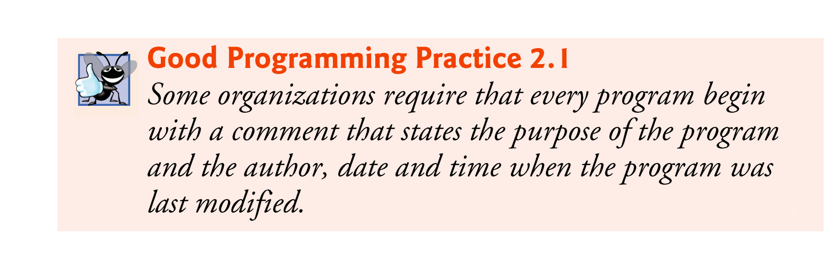

Slide 7
2.2 Our First Program in Java: Printing a Line of Text (Cont.)
Blank lines and space characters
Make programs easier to read.
Blank lines, spaces and tabs are known as white space (or whitespace).
White space is ignored by the compiler.

Slide 8
2.2 Our First Program in Java: Printing a Line of Text (Cont.)
Class declaration
public class Welcome1
Every Java program consists of at least one class that you define.
class keyword introduces a class declaration and is immediately followed by the class name.
Keywords (Appendix C) are reserved for use by Java and are always spelled with all lowercase letters.

Slide 9
2.2 Our First Program in Java: Printing a Line of Text (Cont.)
Class names
By convention, begin with a capital letter and capitalize the first letter of each word they include (e.g., SampleClassName).
A class name is an identifier—a series of characters consisting of letters, digits, underscores (_) and dollar signs ($) that does not begin with a digit and does not contain spaces.
Java is case sensitive—so a1 and A1 are different (but both valid) identifiers.

Slide 10
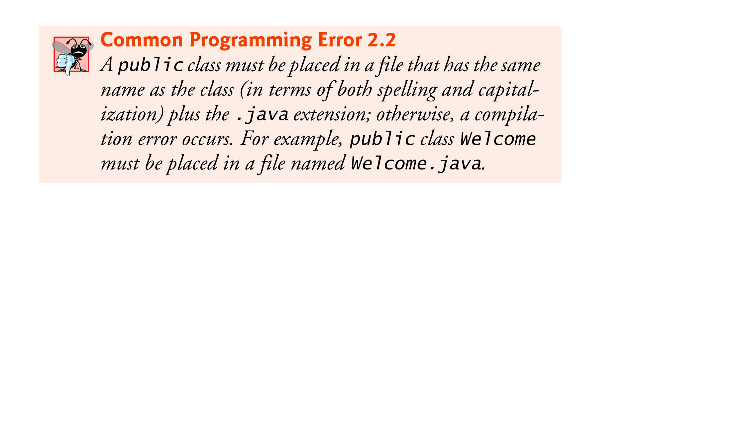

Slide 11
2.2 Our First Program in Java: Printing a Line of Text (Cont.)
Braces
A left brace, {, begins the body of every class declaration.
A corresponding right brace, }, must end each class declaration.
Code between braces should be indented（锯齿状的）.
We recommend using three spaces to form a level of indent.

Slide 12
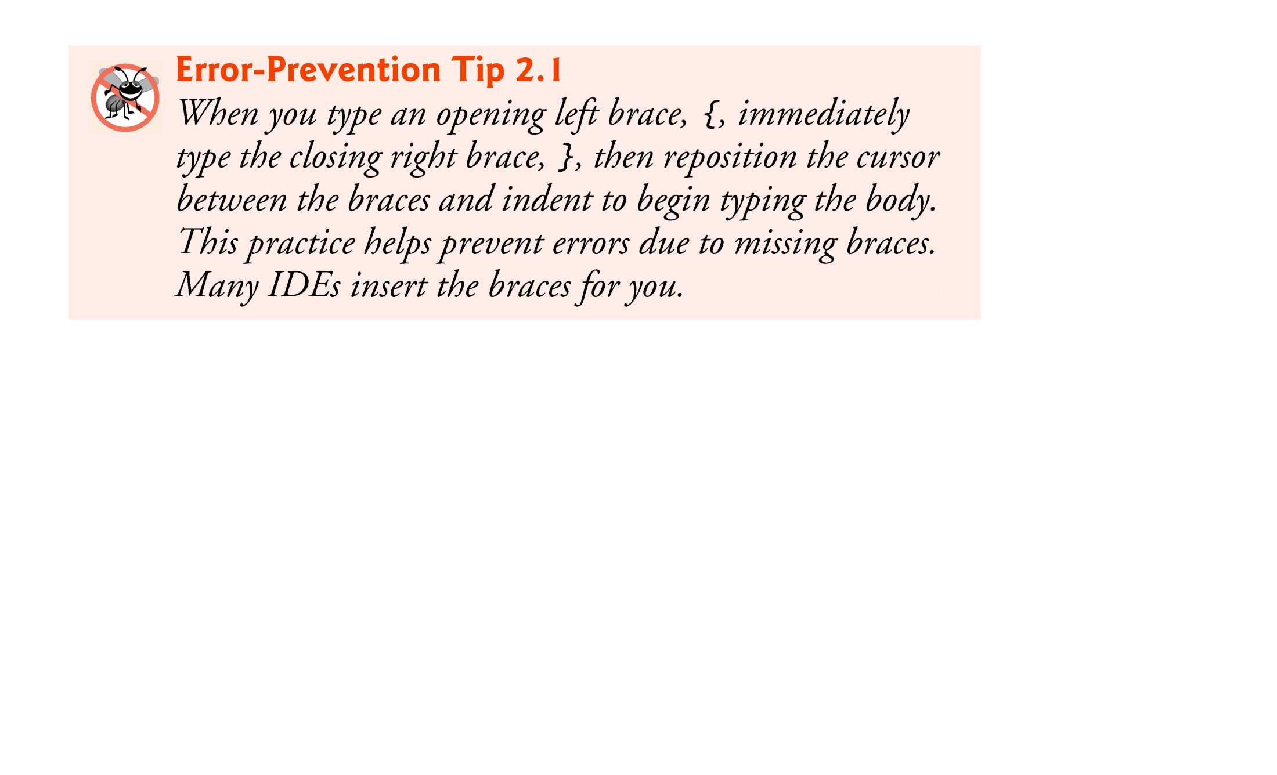

Slide 13
2.2 Our First Program in Java: Printing a Line of Text (Cont.)
Declaring the main Method
public static void main( String[] args )
Starting point of every Java application.
Parentheses() after the identifier main indicate that it’s a program building block called a method.
Java class declarations normally contain one or more methods.
main must be defined as shown; otherwise, the JVM will not execute the application.
Keyword void indicates that this method will not return any information.

Slide 14
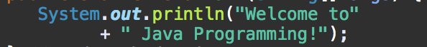
2.2 Our First Program in Java: Printing a Line of Text (Cont.)
Body of the method declaration
Enclosed in left and right braces.
Statement
System.out.println("Welcome to Java Programming!");
Instructs the computer to perform an action
Print the string of characters contained between the double quotation marks.
White-space characters in strings are not ignored by the compiler.
Strings cannot span multiple lines of code.

Slide 15
2.2 Our First Program in Java: Printing a Line of Text (Cont.)
System.out object
Standard output object.
Allows Java applications to display strings in the command window from which the Java application executes.
System.out.println method
Displays (or prints) a line of text in the command window.
The string in the parentheses the argument to the method.
Positions the output cursor at the beginning of the next line in the command window.
Most statements end with a semicolon.

Slide 16
2.2 Our First Program in Java: Printing a Line of Text (Cont.)
Compiling and Executing Your First Java Application
Open a command window and change to the directory where the program is stored.
Many operating systems use the command cd to change directories.
To compile the program, type
javac Welcome1.java
If the program contains no syntax errors, preceding command creates a.class file (known as the class file) containing the platform-independent Java bytecodes that represent the application.

Slide 17
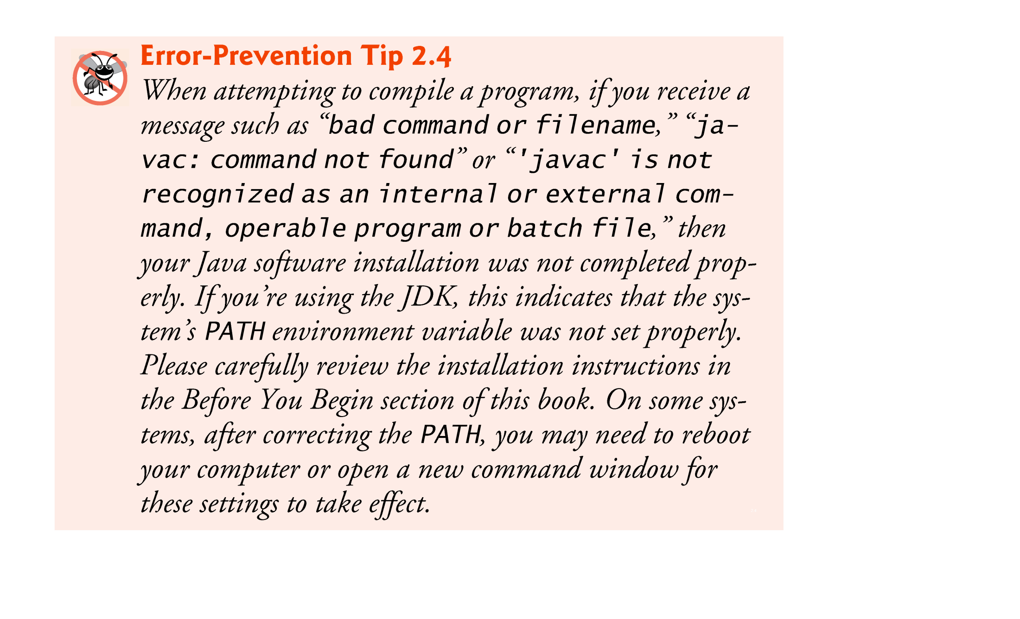

Slide 18
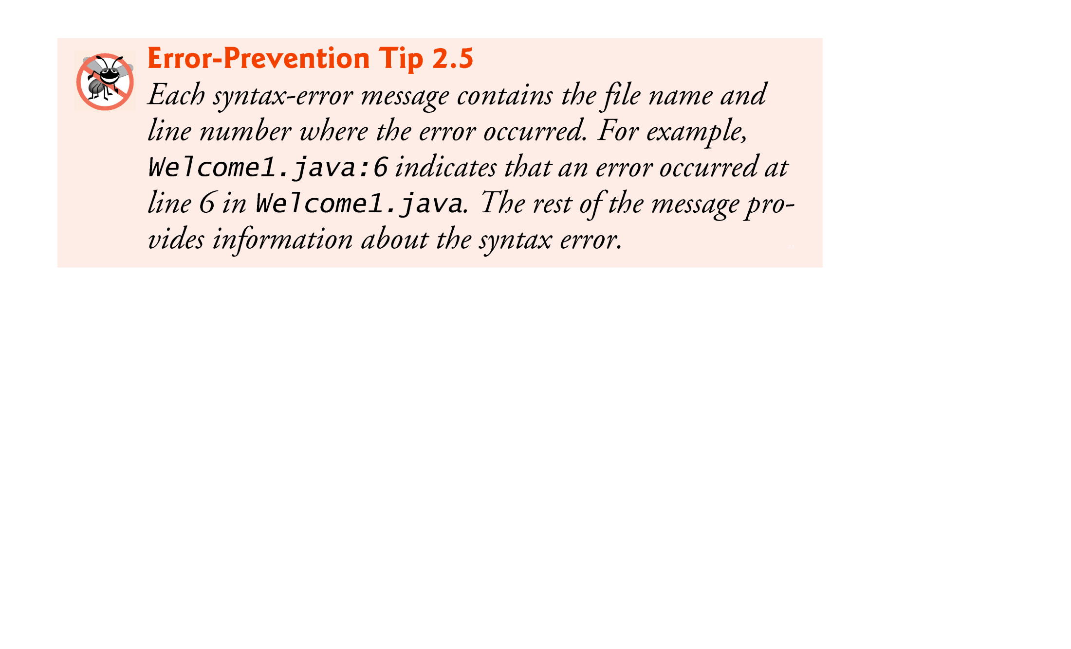

Slide 19
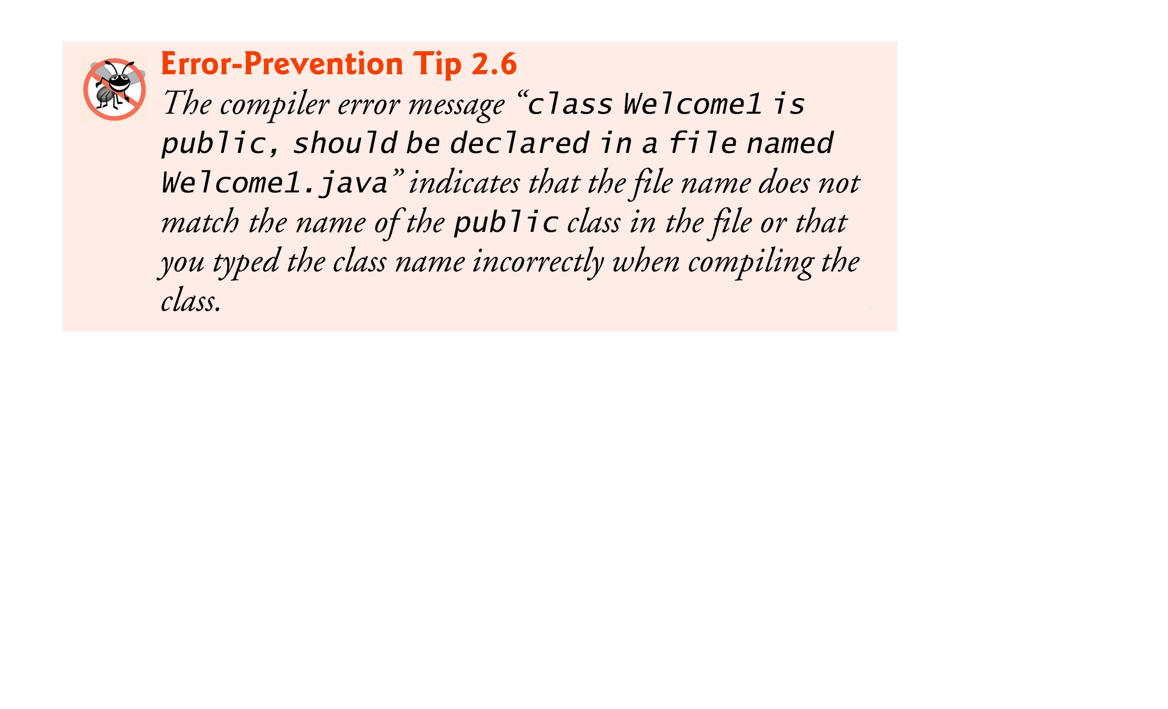

Slide 20
2.2 Our First Program in Java: Printing a Line of Text (Cont.)
To execute the program, type java Welcome1.
Launches the JVM, which loads the .class file for class Welcome1.
Note that the .class file-name extension is omitted from the preceding command; otherwise, the JVM will not execute the program.
The JVM calls method main to execute the program.

Slide 21
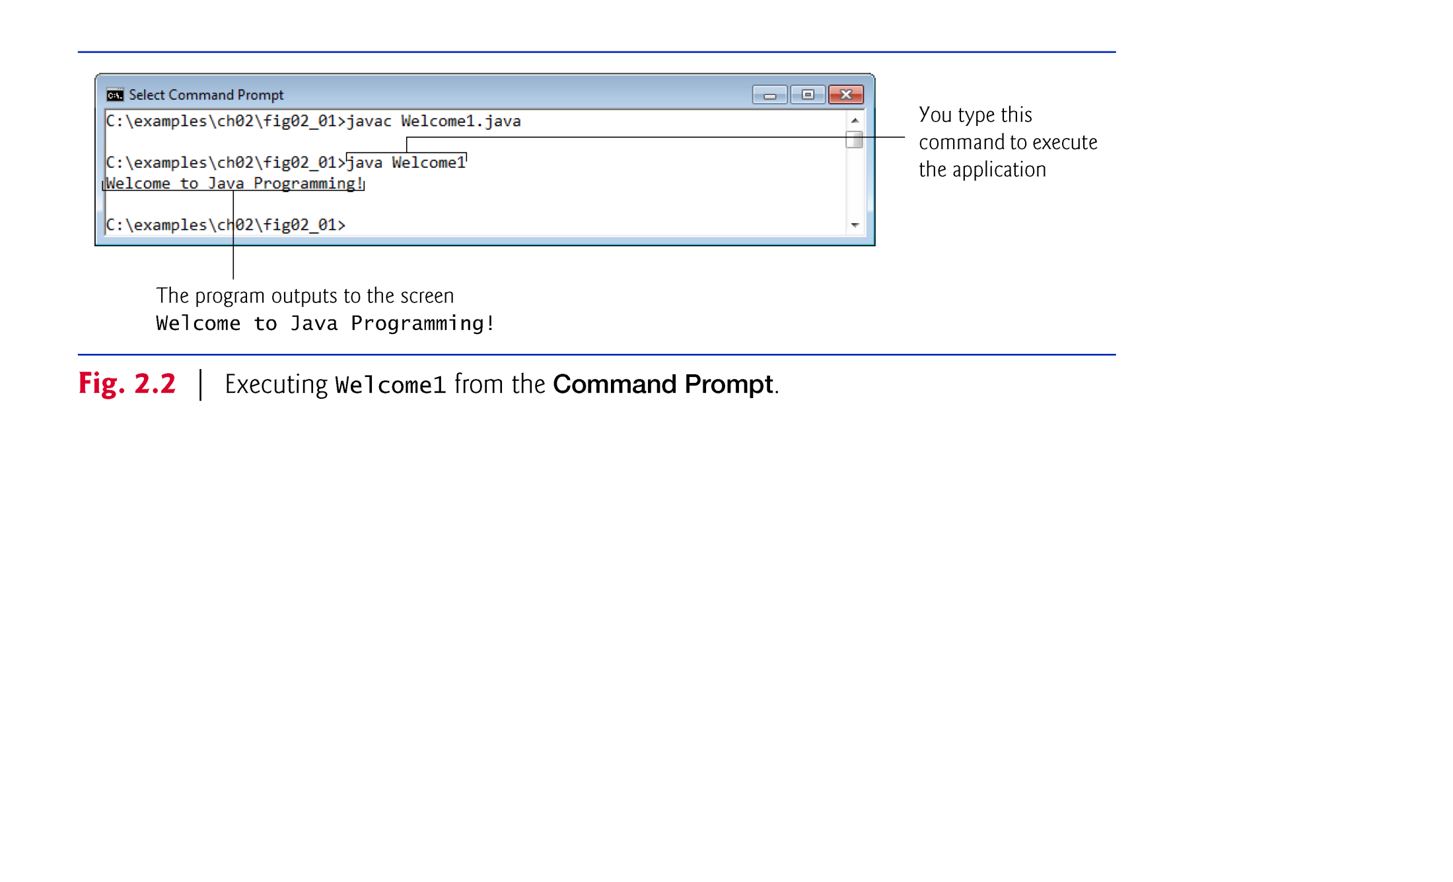

Slide 22
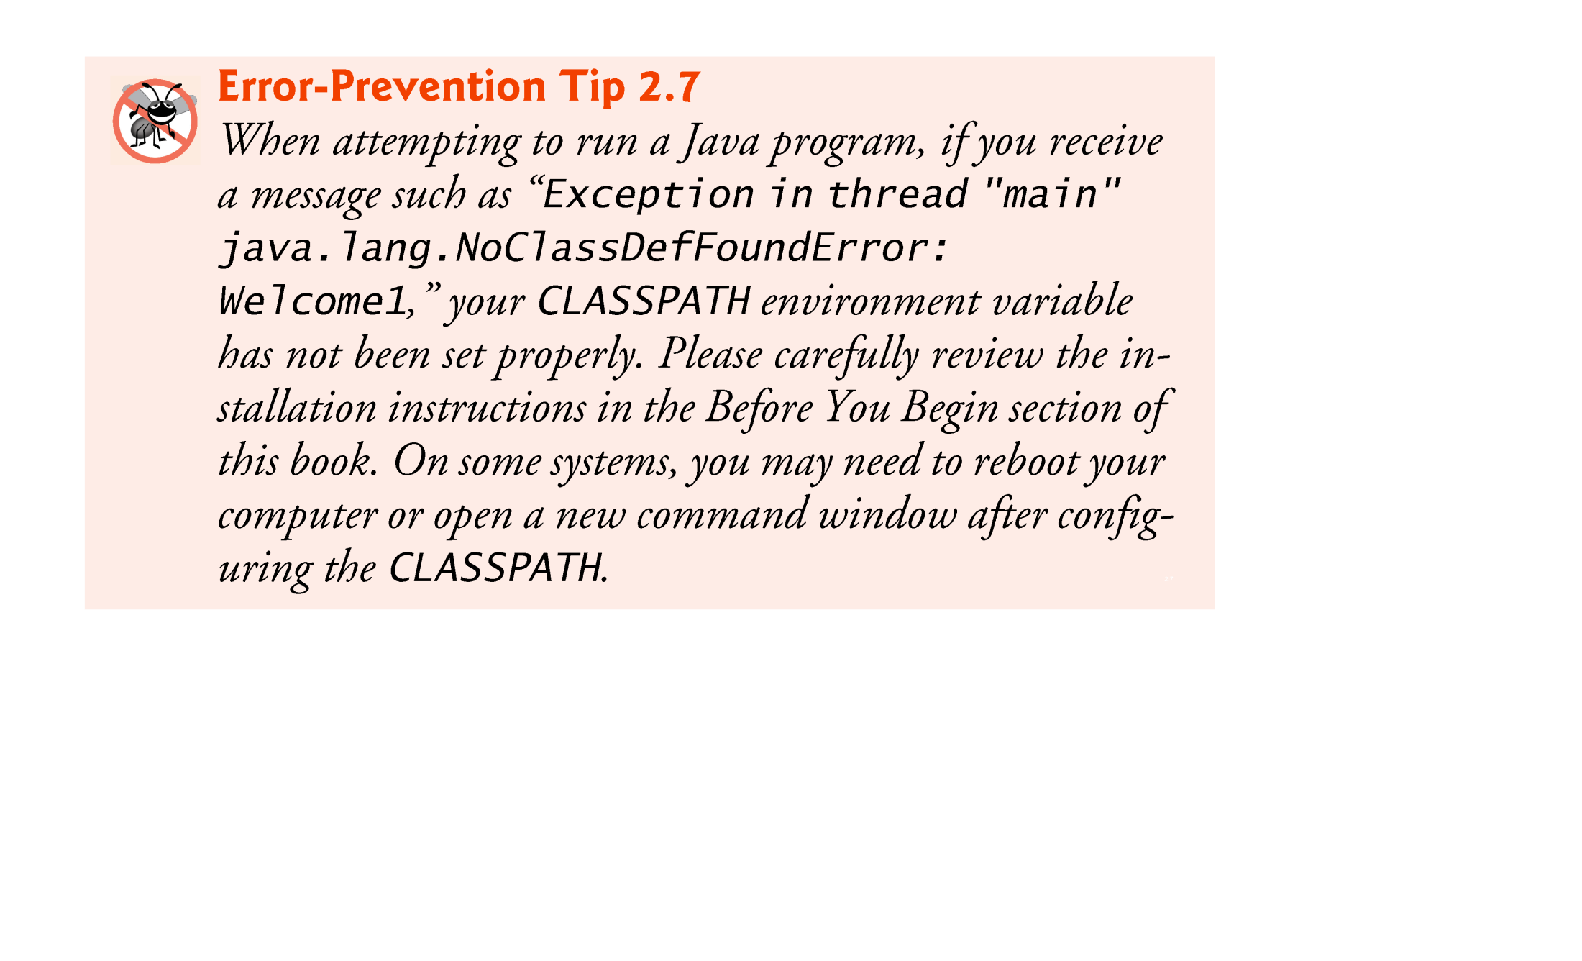

Slide 23
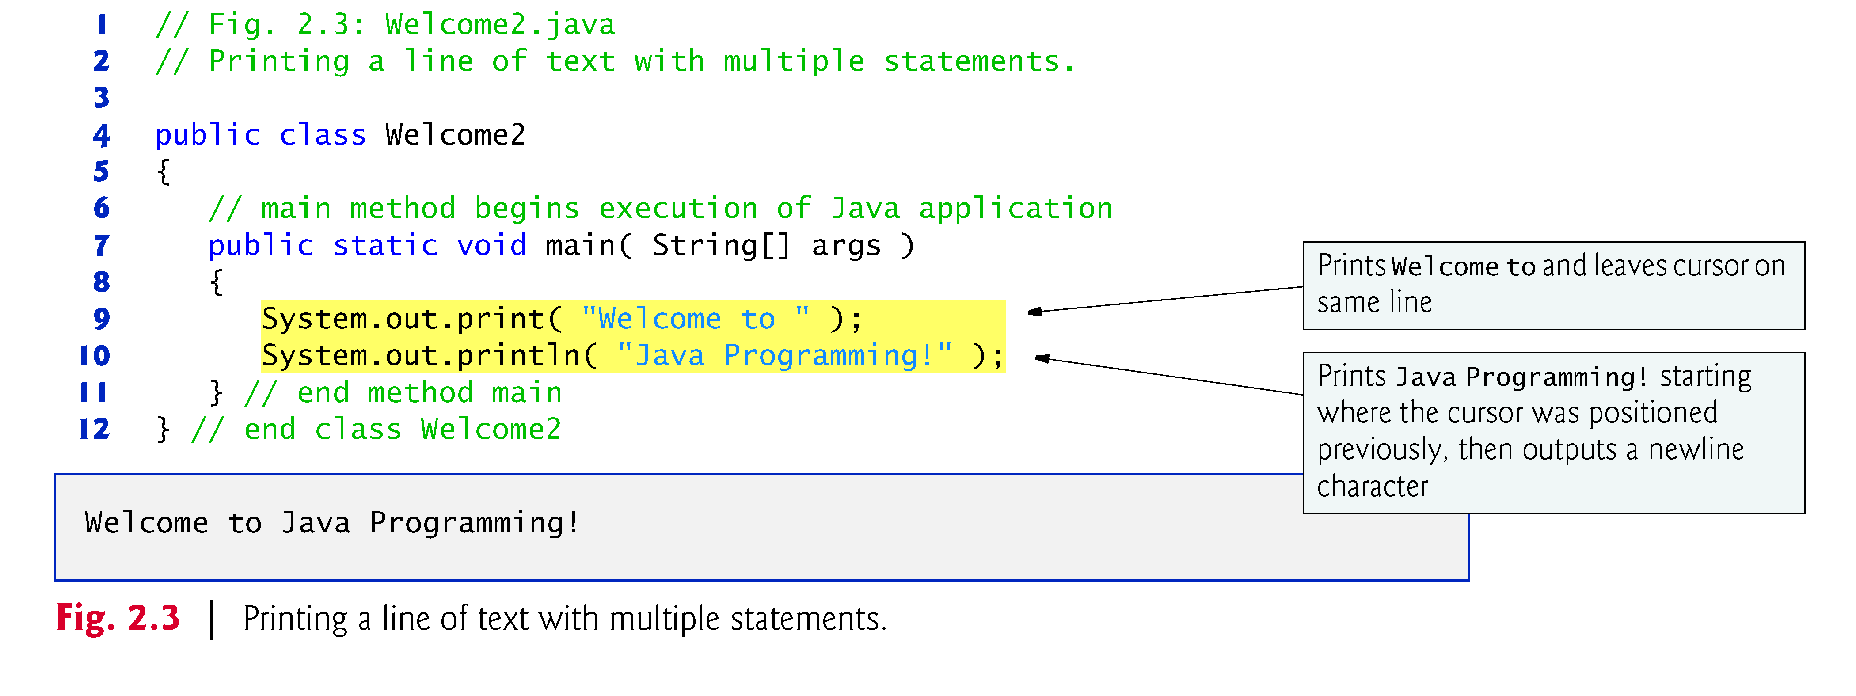
2.3 Modifying Your First Java Program
Class Welcome2, shown in Fig. 2.3, uses two statements to produce the same output as that shown in Fig. 2.1.

Slide 24
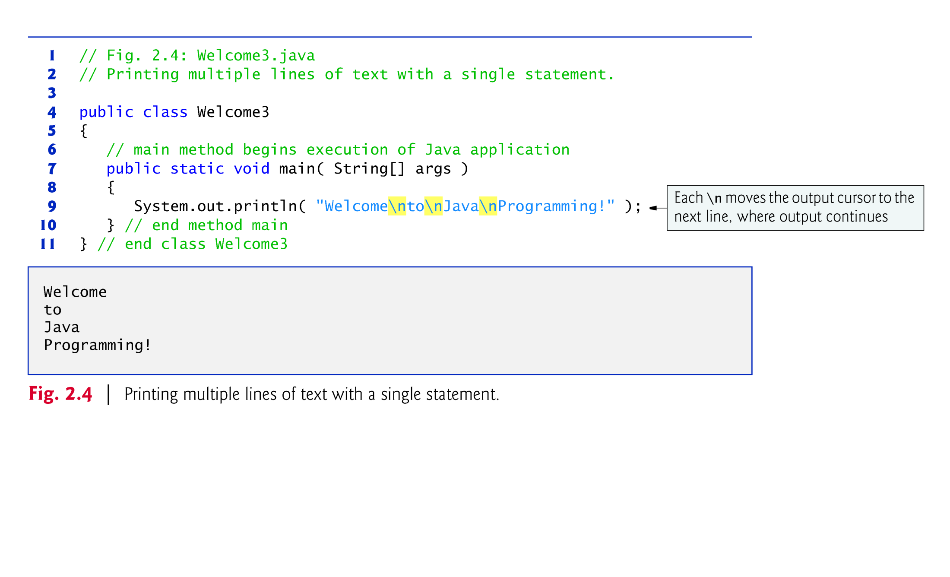

Slide 25
2.3 Modifying Your First Java Program (Cont.)
Newline characters indicate to System.out’s print and println methods when to position the output cursor at the beginning of the next line in the command window.
Newline characters are white-space characters.
The backslash (\) is called an escape character.
Indicates a “special character”
Backslash is combined with the next character to form an escape sequence.
The escape sequence \n represents the newline character.

Slide 26
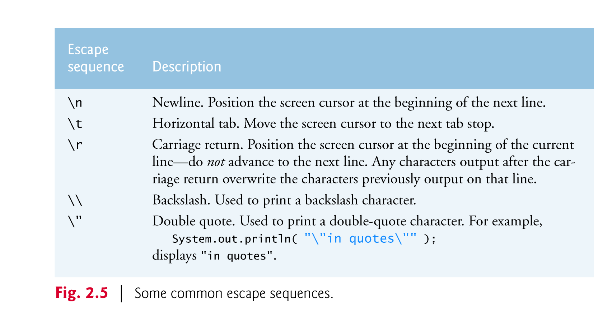

Slide 27
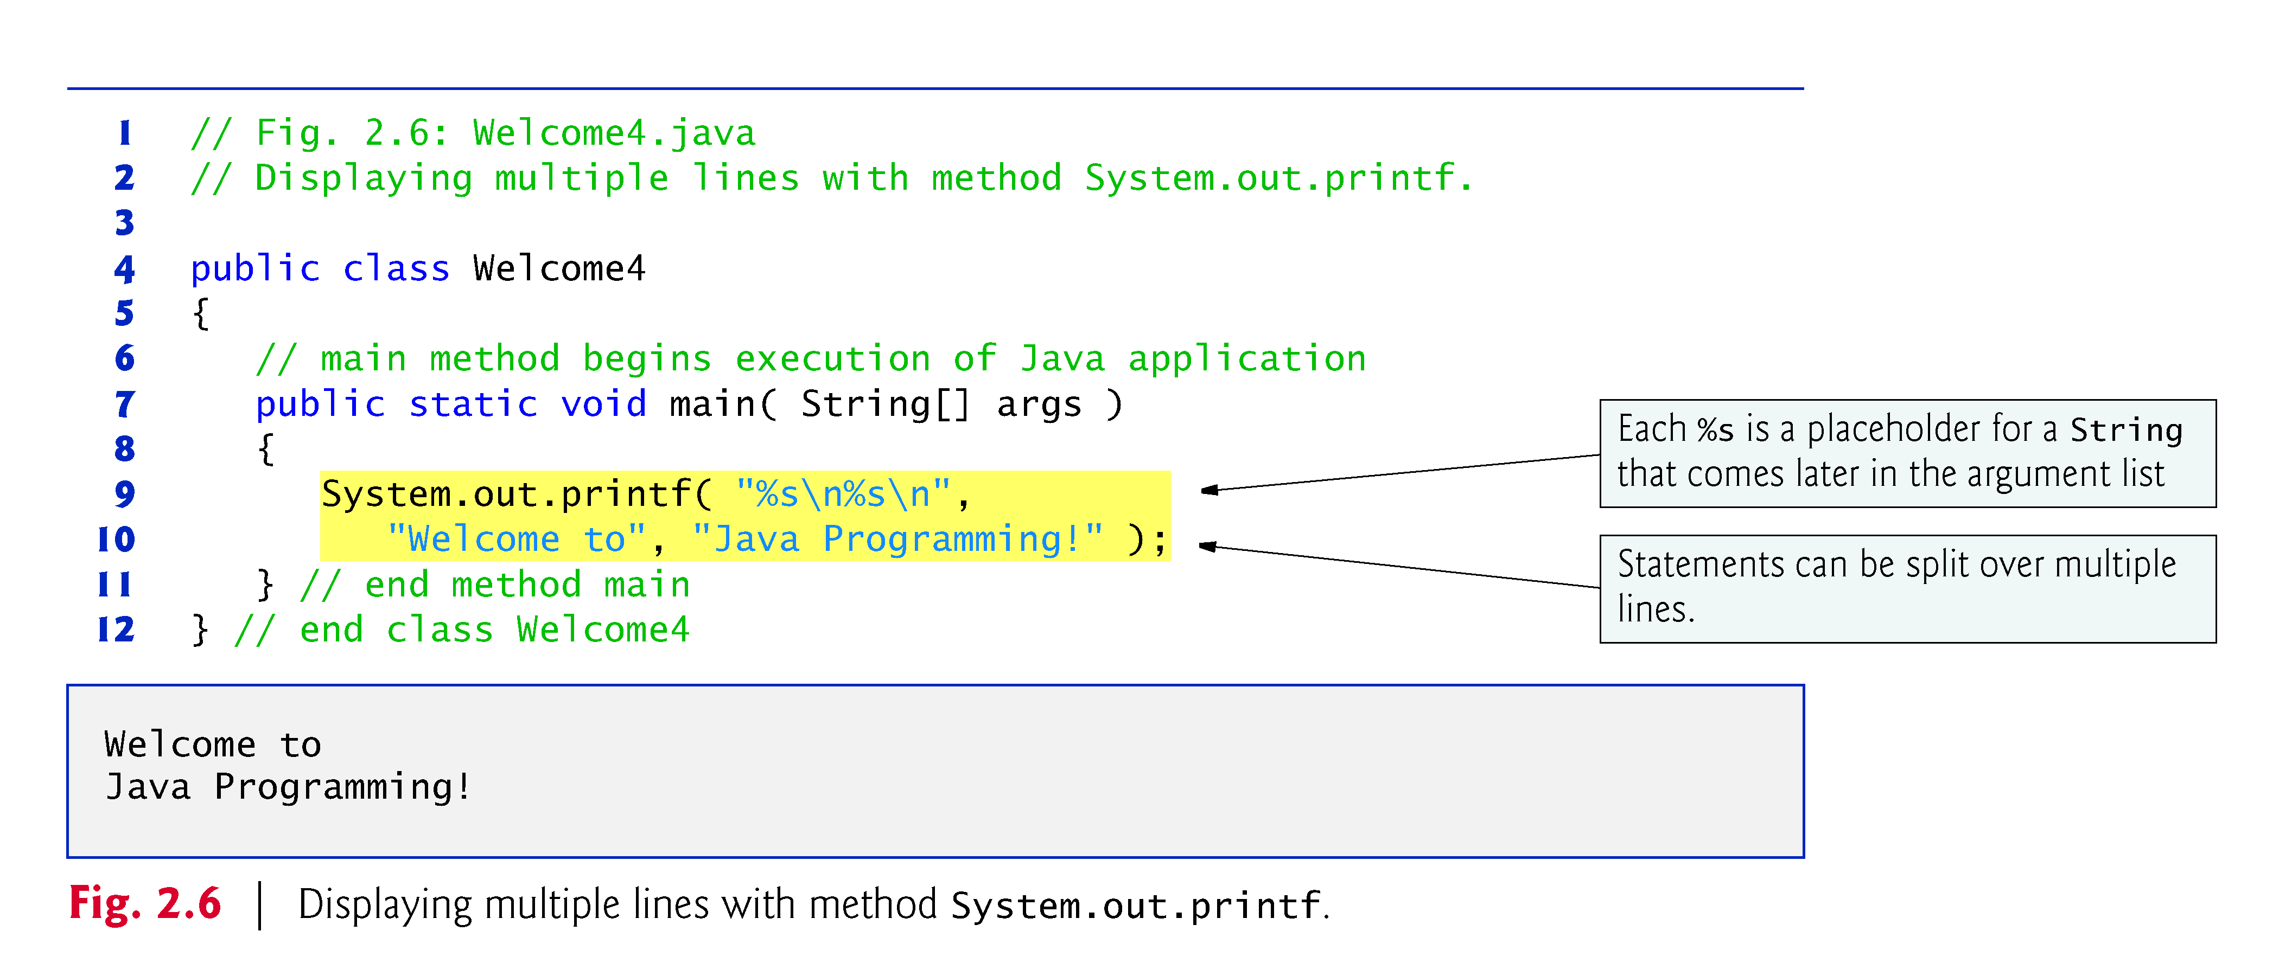
2.4 Displaying Text with printf
System.out.printf method
f means “formatted”
displays formatted data

Slide 28
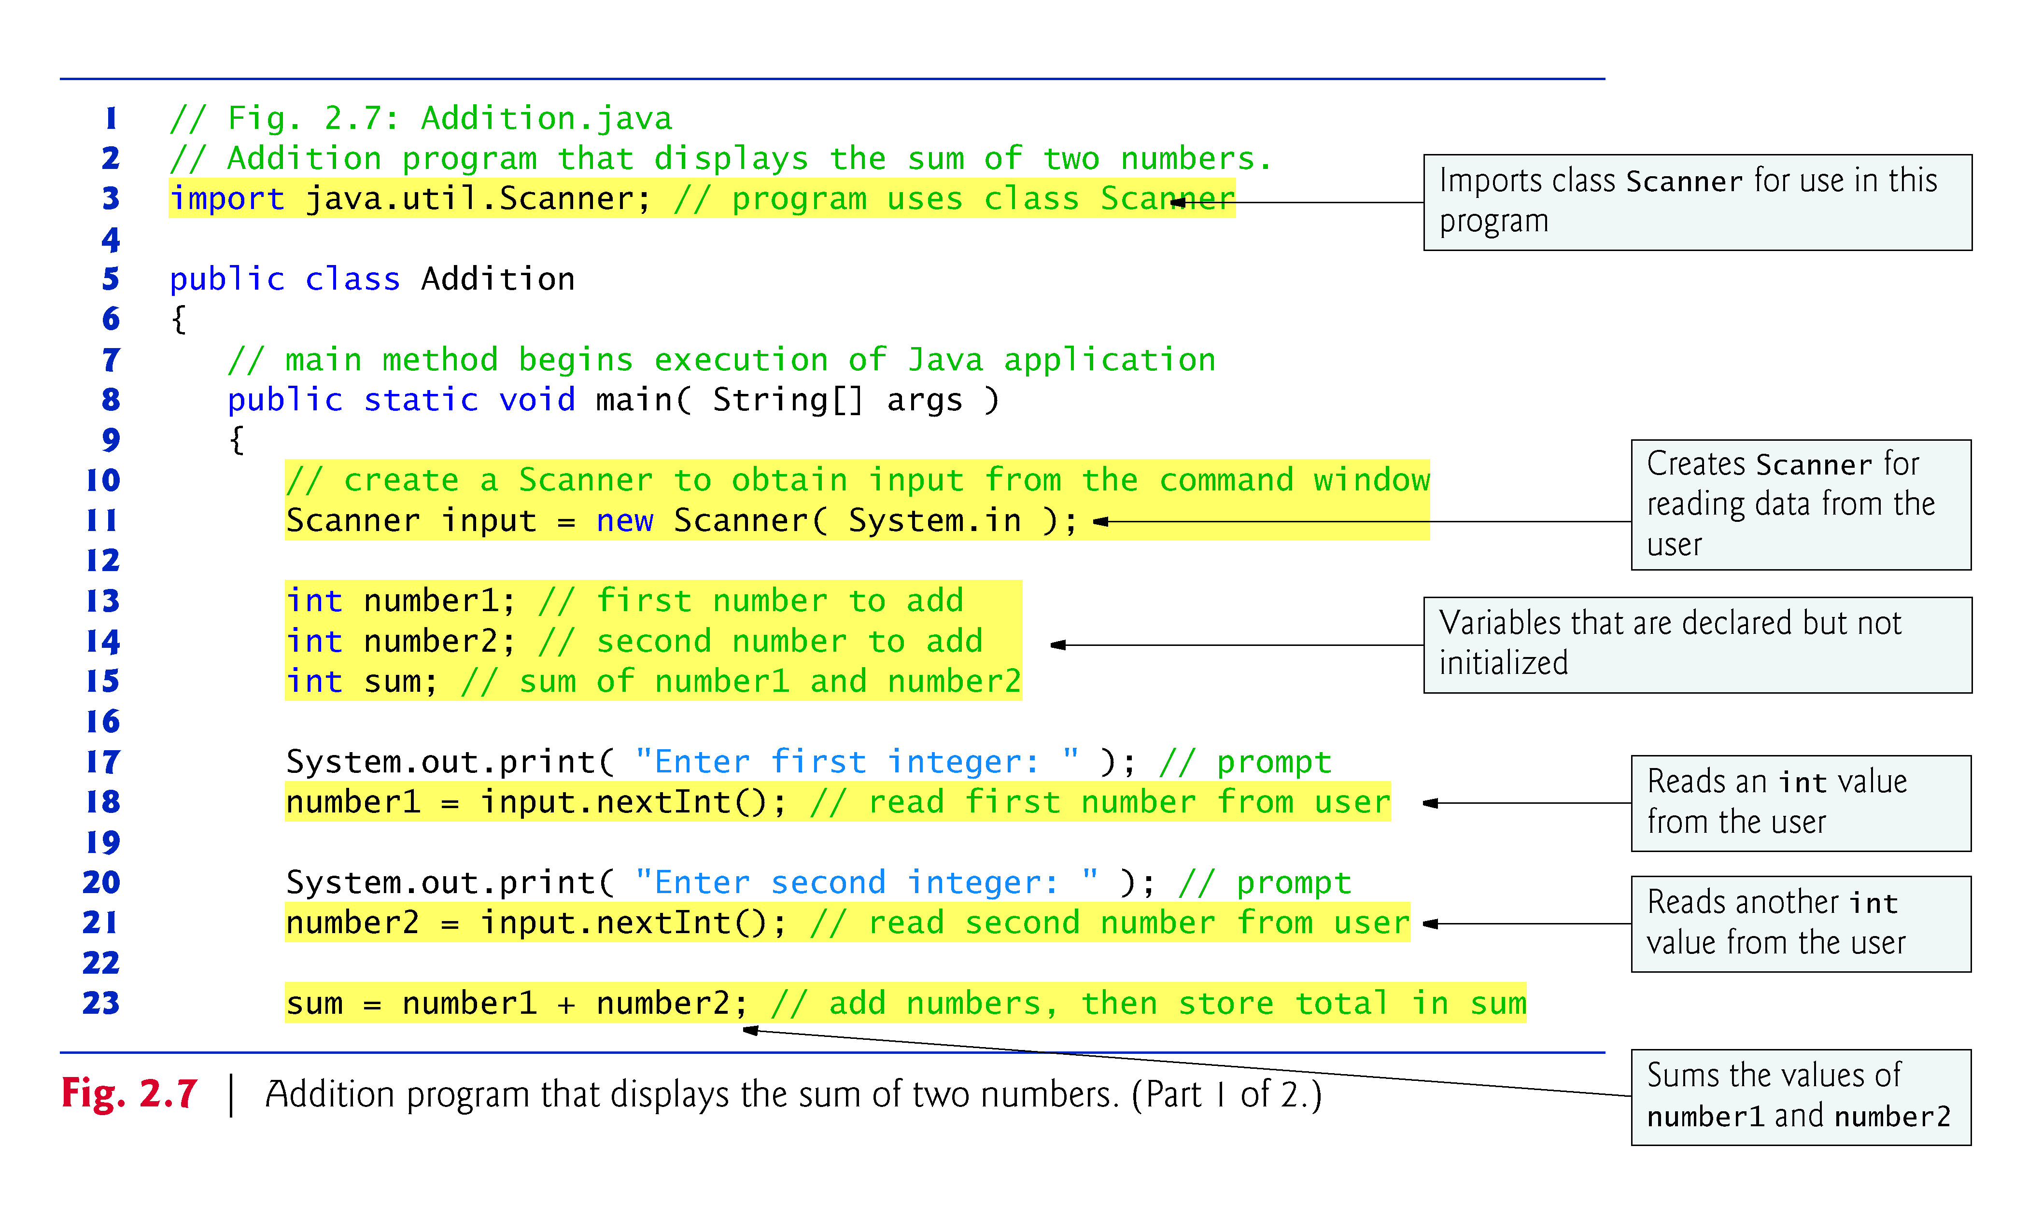
2.5 Another Application: Adding Integers

Slide 29
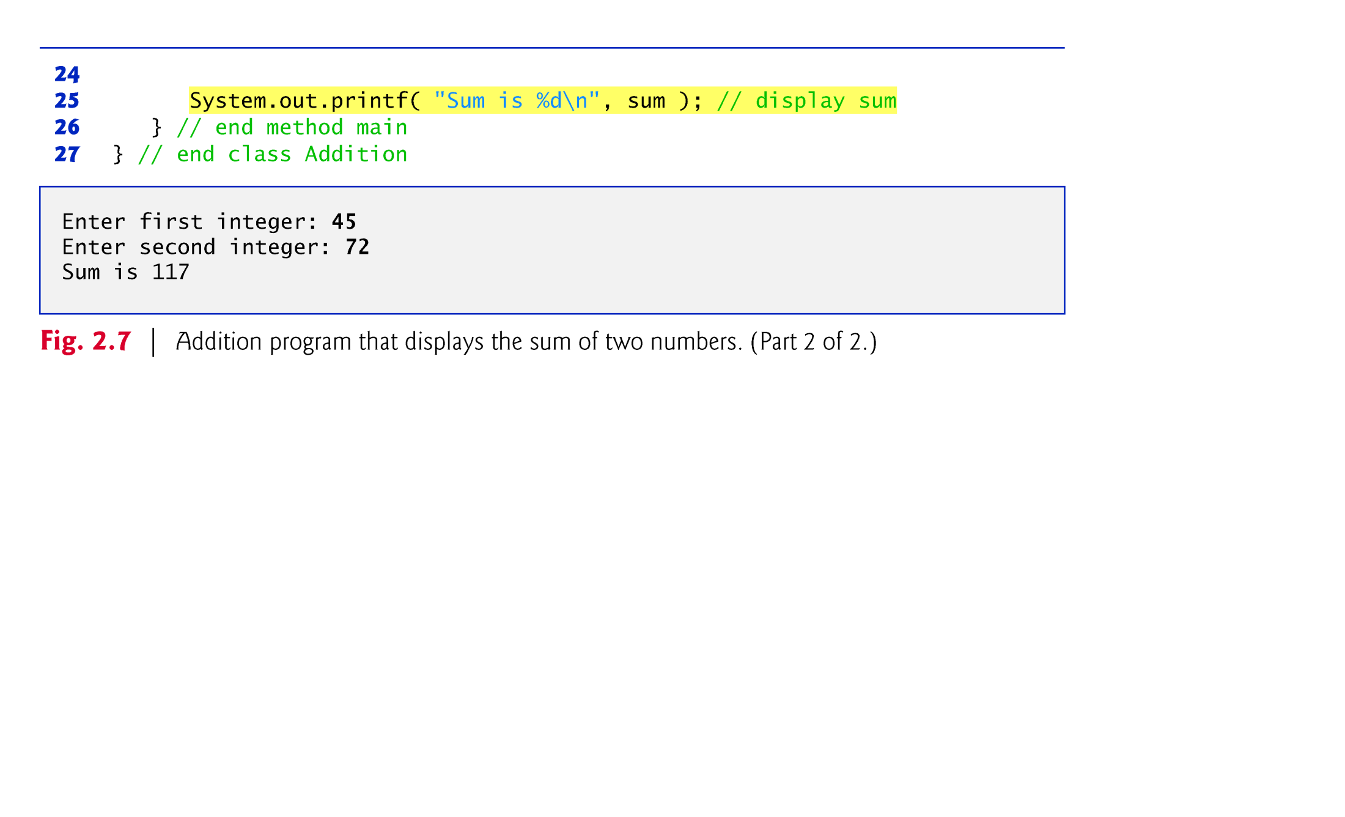

Slide 30
2.5 Another Application: Adding Integers (Cont.)
import declaration
Helps the compiler locate a class that is used in this program.
Rich set of predefined classes that you can reuse rather than “reinventing the wheel.”
Classes are grouped into packages—named groups of related classes—and are collectively referred to as the Java class library, or the Java Application Programming Interface (Java API).
You use import declarations to identify the predefined classes used in a Java program.

Slide 31
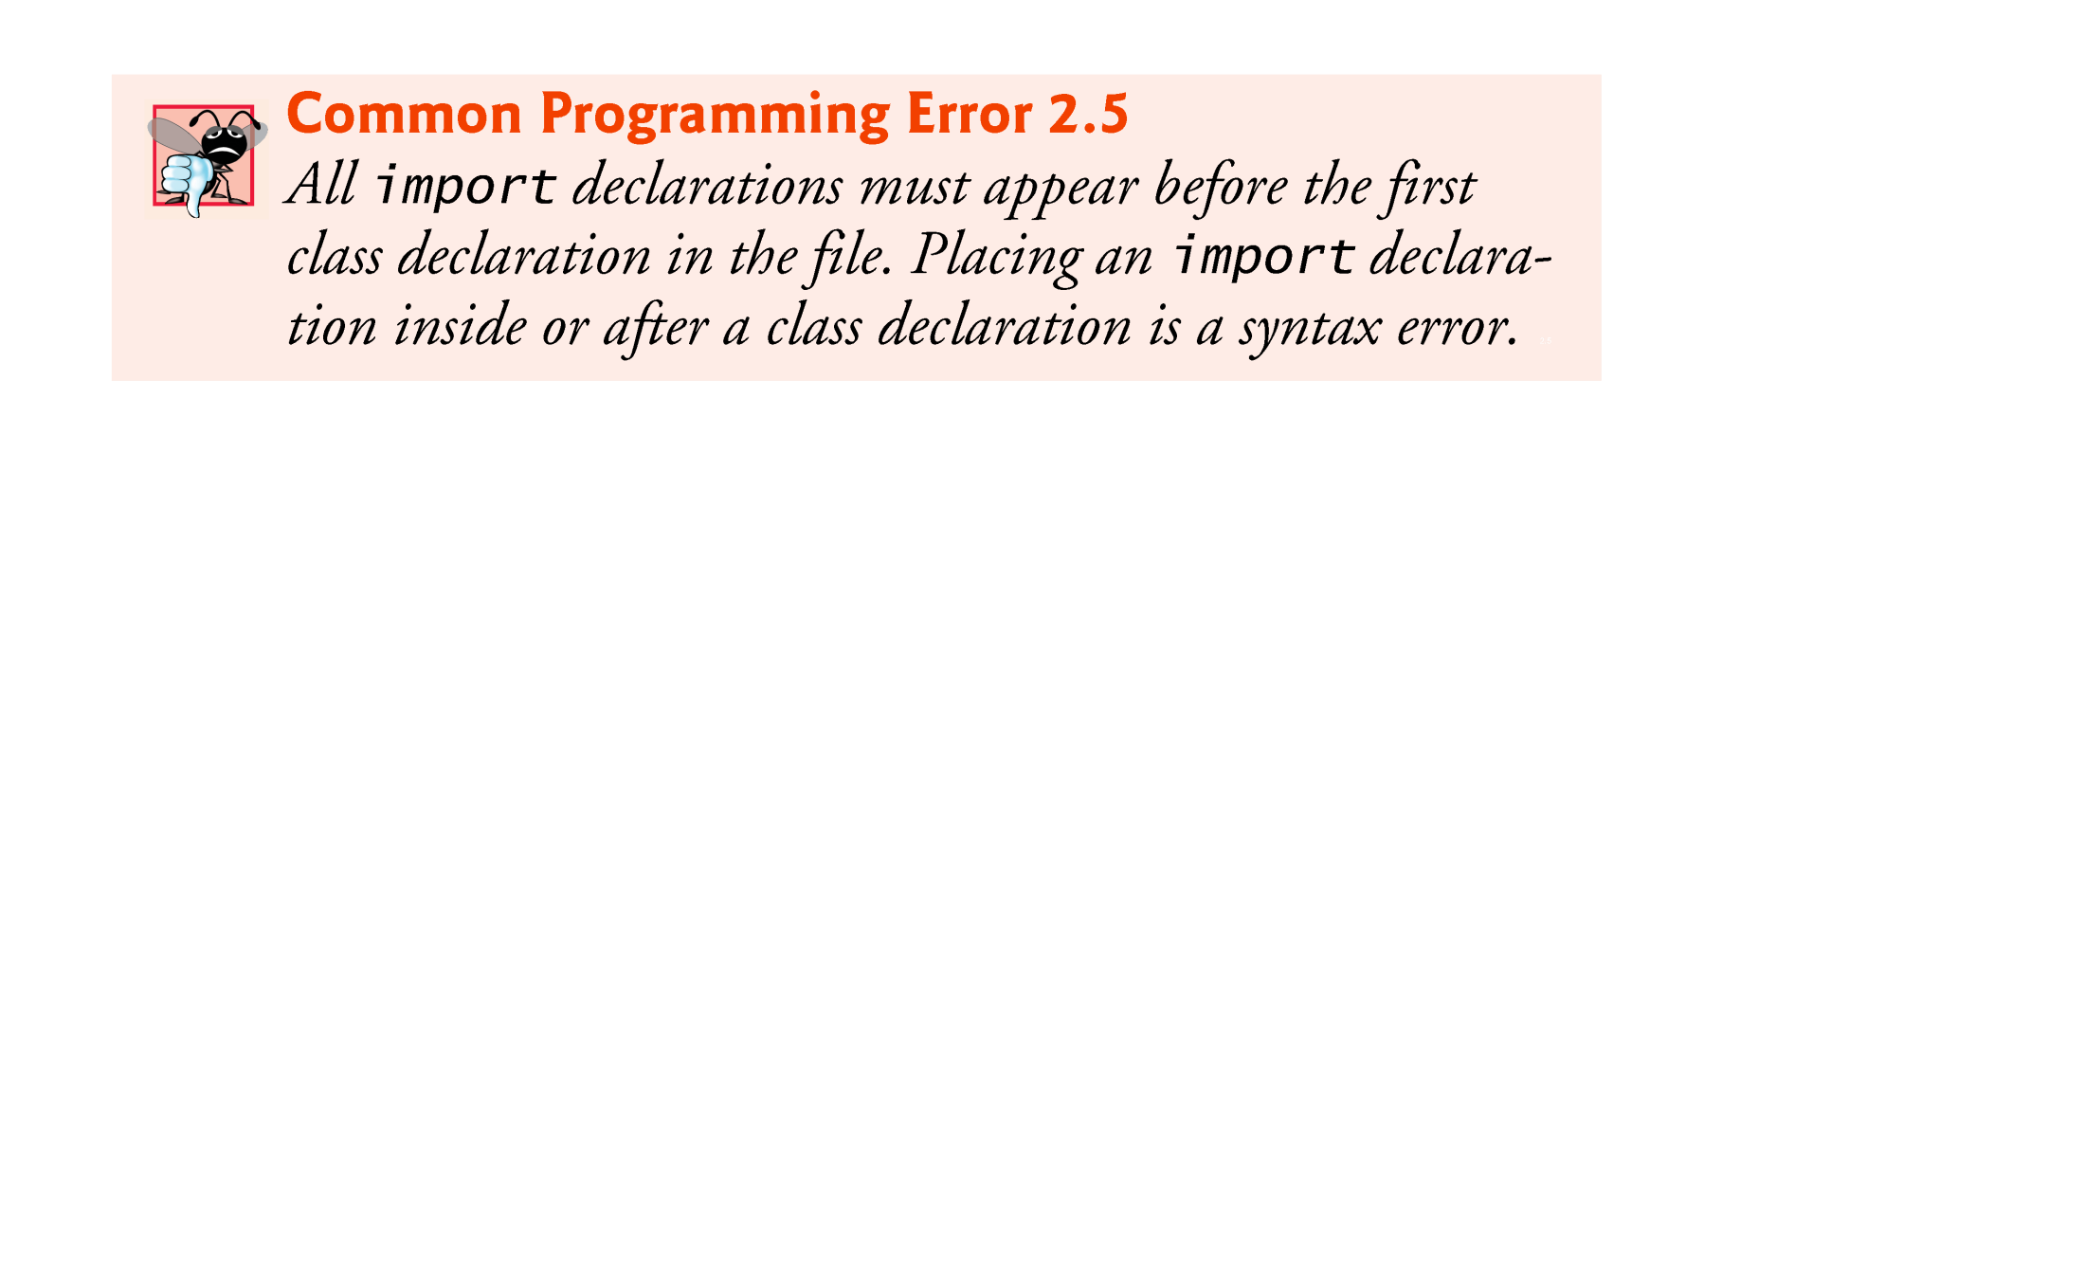

Slide 32
2.5 Another Application: Adding Integers (Cont.)
Variable declaration statement
Scanner input = new Scanner( System.in );
Specifies the name (input) and type (Scanner) of a variable that is used in this program.
Variable
Must be declared with a name and a type before they can be used.

Slide 33
2.5 Another Application: Adding Integers (Cont.)
Scanner
Enables a program to read data for use in a program.
Data can come from many sources, such as the user at the keyboard or a file on disk.
Before using a Scanner, you must create it and specify the source of the data.
The equals sign (=) in a declaration indicates that the variable should be initialized (i.e., prepared for use in the program) with the result of the expression to the right of the equals sign.
The new keyword creates an object.
Standard input object, System.in, enables applications to read bytes of information typed by the user.
Scanner object translates these bytes into types that can be used in a program.

Slide 34
2.5 Another Application: Adding Integers (Cont.)
Variable declaration statements
int number1; // first number to add int number2; // second number to add int sum; // sum of number1 and number2
declare that variables number1, number2 and sum hold data of type int
They can hold integer.
Range of values for an int is –2,147,483,648 to +2,147,483,647.
Actual int values may not contain commas.
Several variables of the same type may be declared in one declaration with the variable names separated by commas.

Slide 35


Slide 36
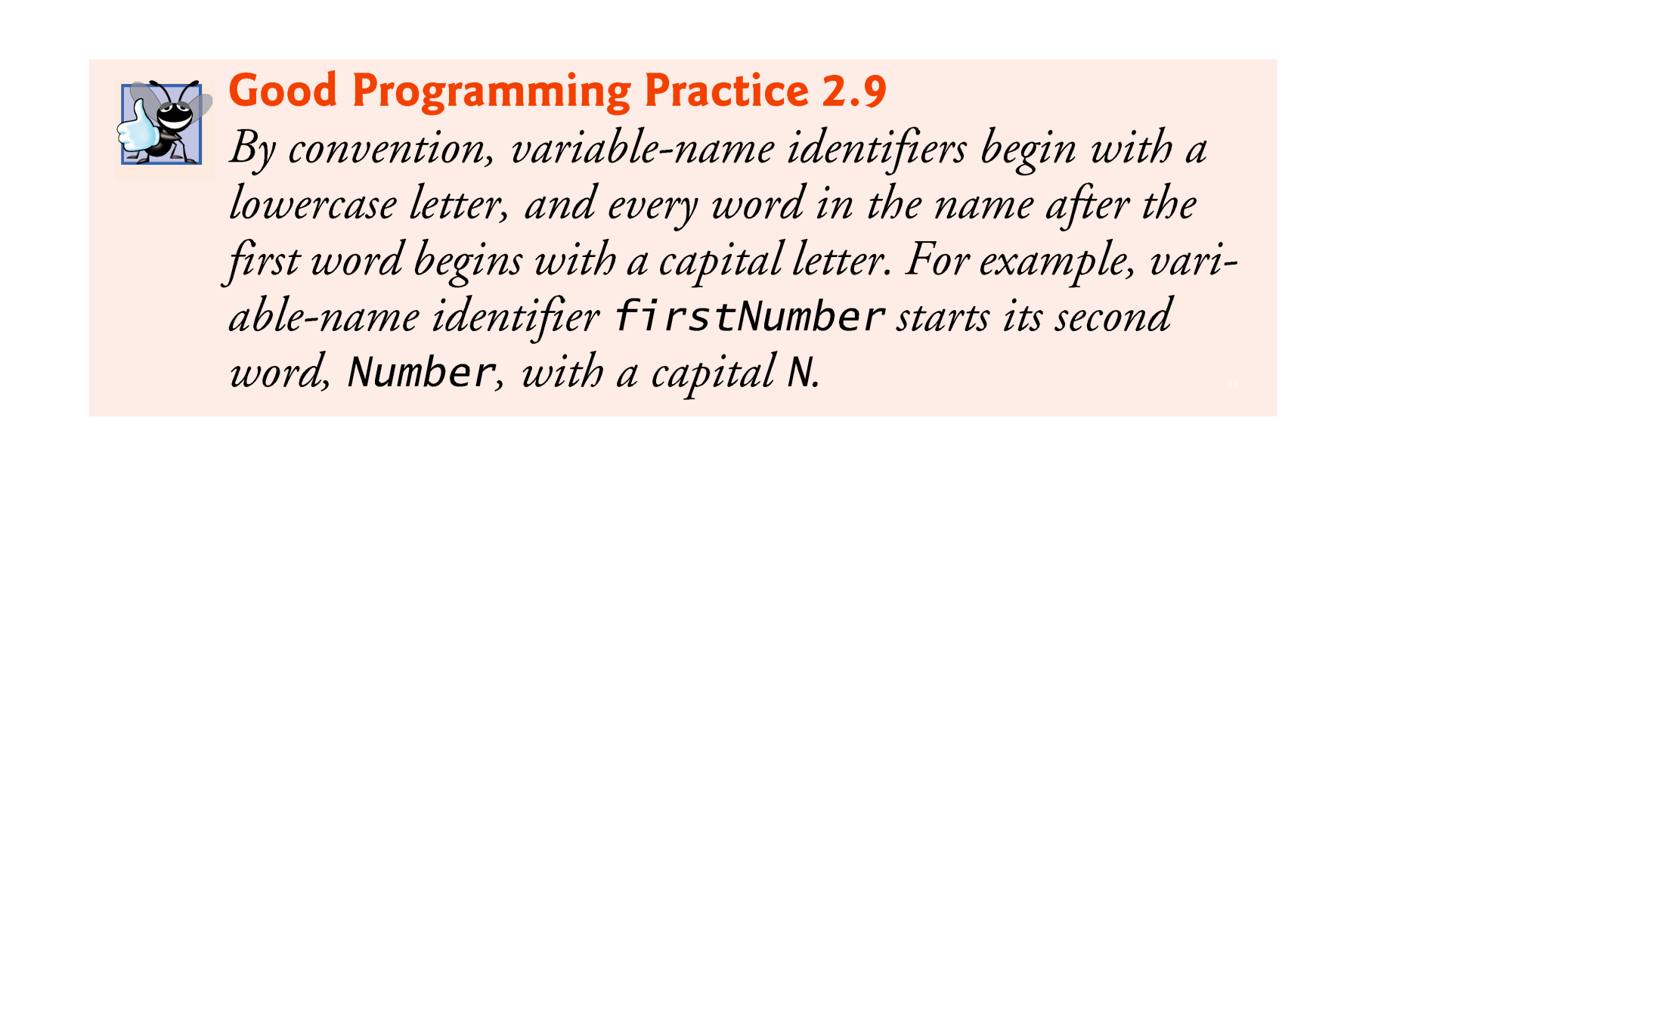

Slide 37
2.5 Another Application: Adding Integers (Cont.)
Prompt
Output statement that directs the user to take a specific action.
System is a class.
Part of package java.lang.
Class System is not imported with an import declaration at the beginning of the program.

Slide 38
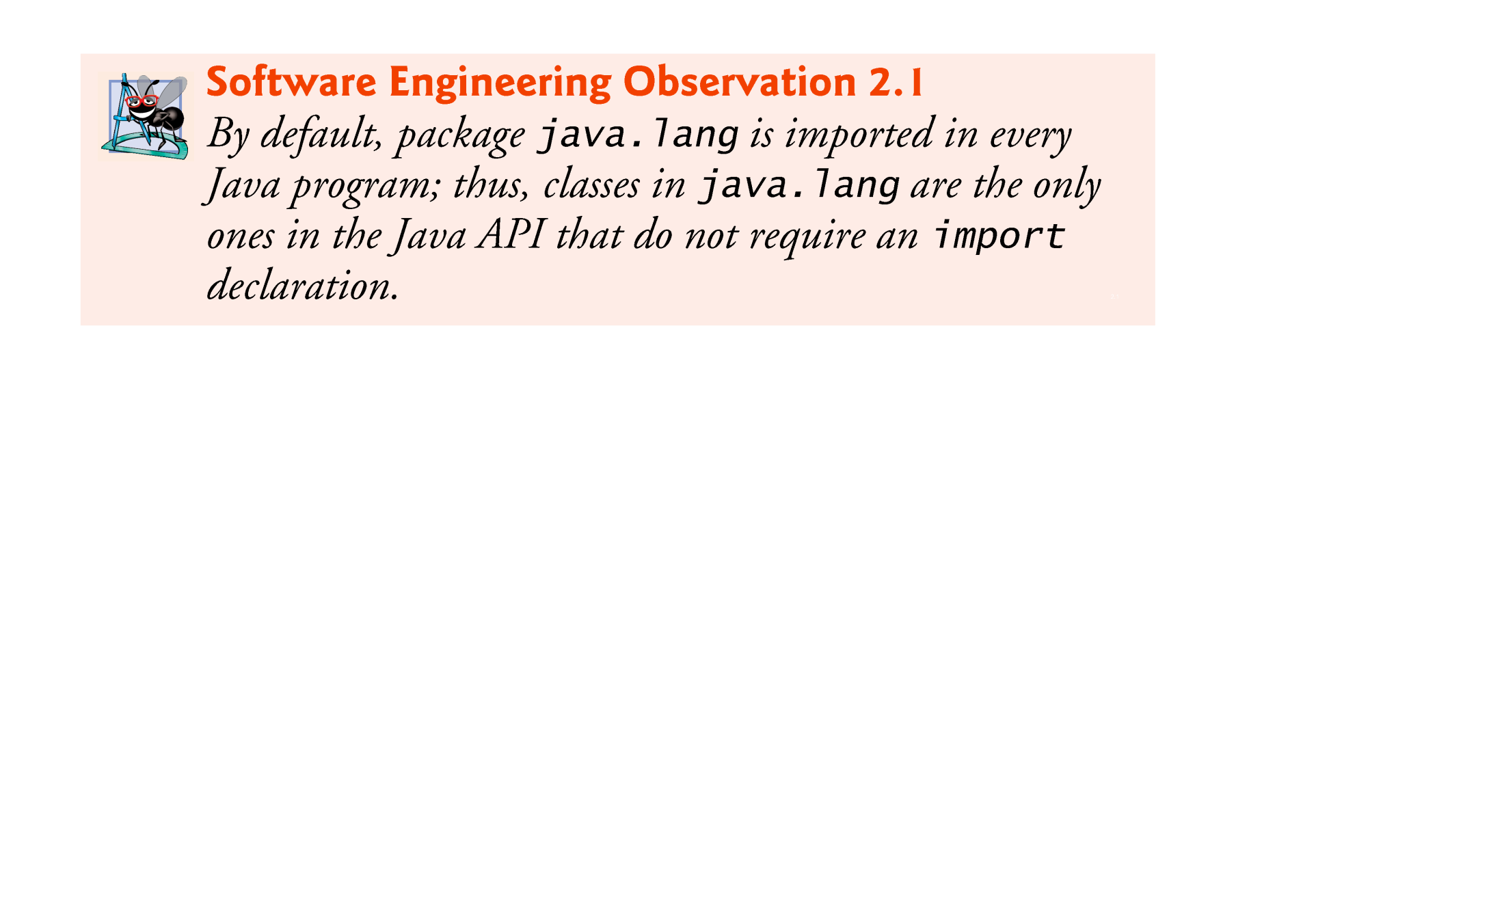

Slide 39
2.5 Another Application: Adding Integers (Cont.)
Scanner method nextInt
number1 = input.nextInt(); // read first number from user
Obtains an integer from the user at the keyboard.
Program waits for the user to type the number and press the Enter key to submit the number to the program.

Slide 40
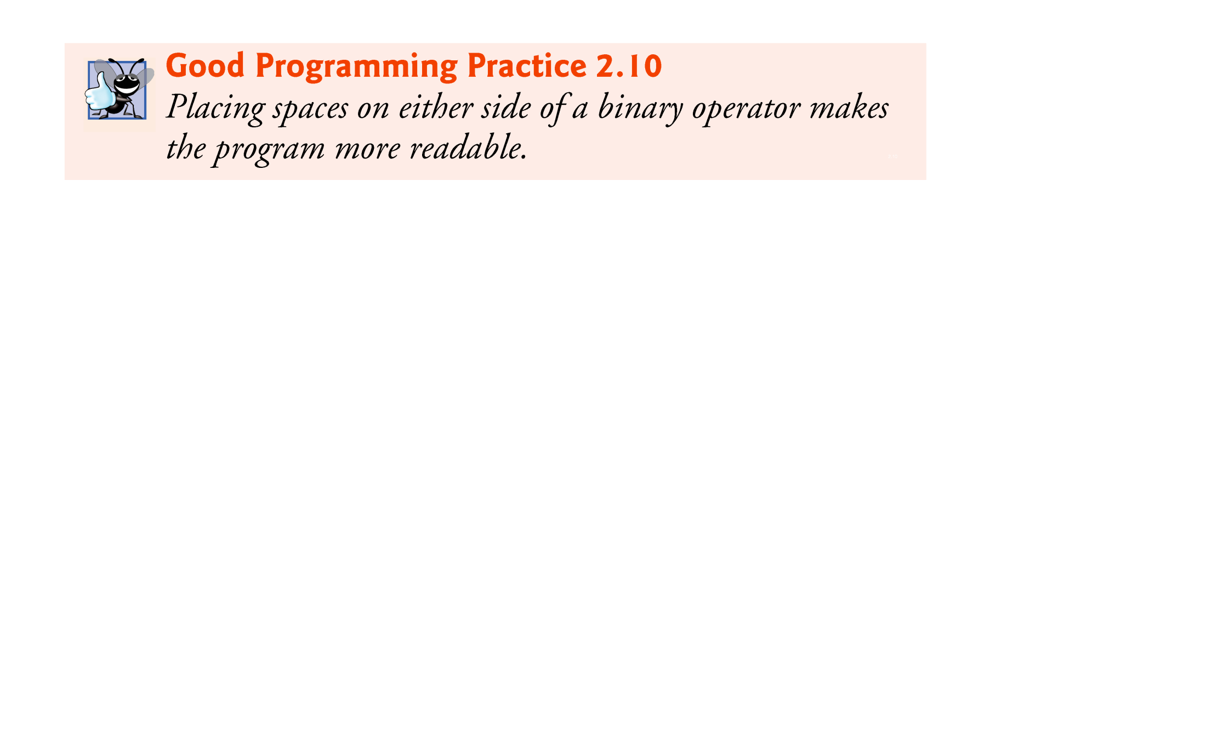

Slide 41
2.5 Another Application: Adding Integers (Cont.)
Arithmetic
sum = number1 + number2; // add numbers
“sum gets the value of number1 + number2.”
In general, calculations are performed in assignment statements.
Portions of statements that contain calculations are called expressions.

Slide 42
2.5 Another Application: Adding Integers (Cont.)
Integer formatted output
System.out.printf( "Sum is %d\n", sum );
Format specifier %d is a placeholder for an int value
The letter d stands for “decimal integer.”

Slide 43
2.6 Memory Concepts
Variables
Every variable has a name, a type, a size (in bytes) and a value.
When a new value is placed into a variable, the new value replaces the previous value (if any)
The previous value is lost.

Slide 44
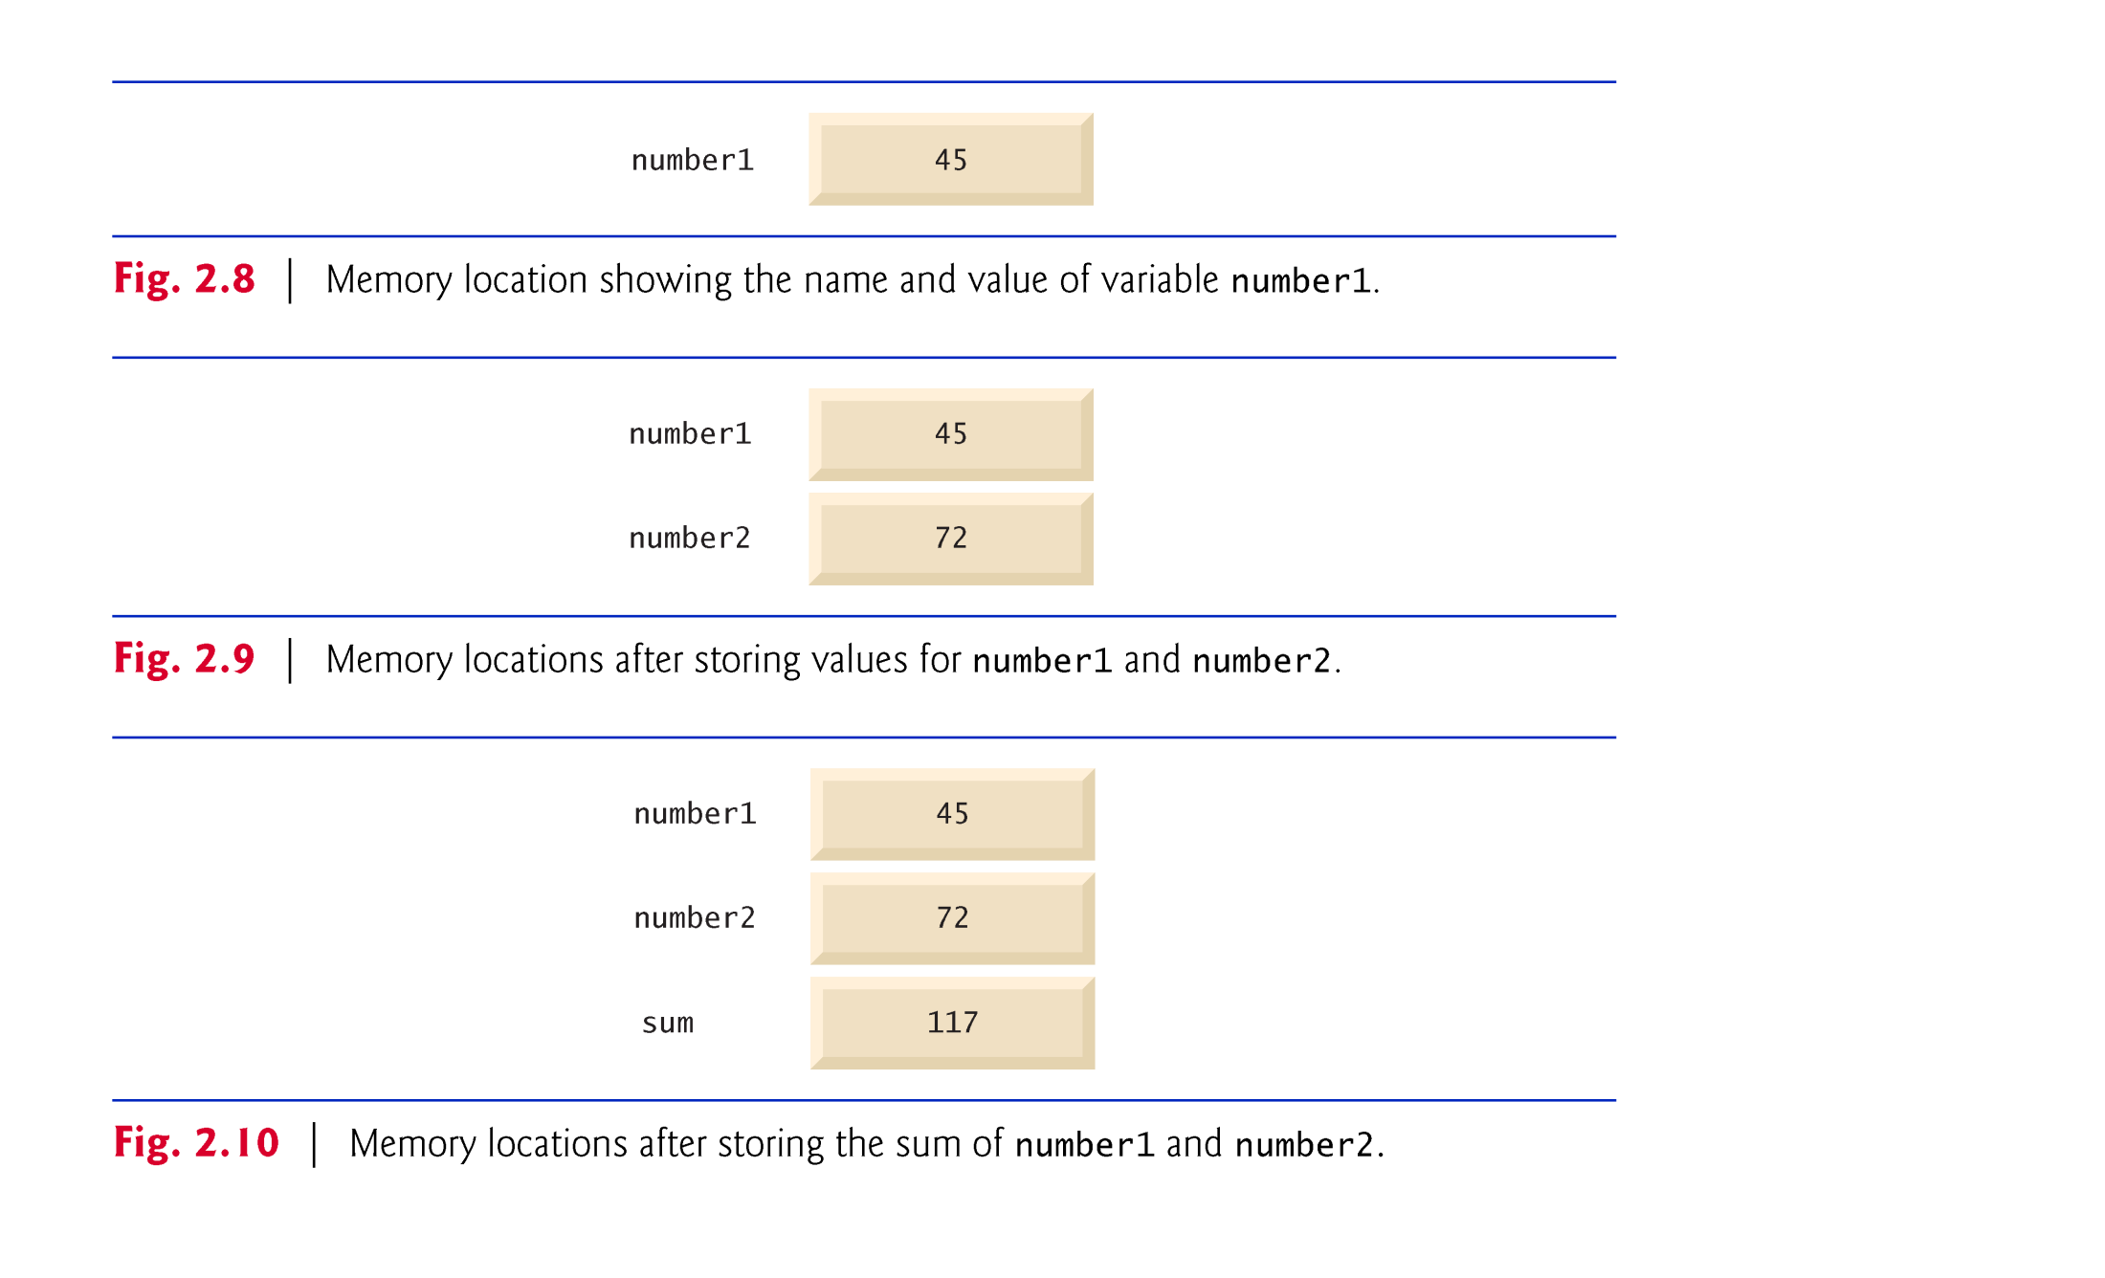

Slide 45
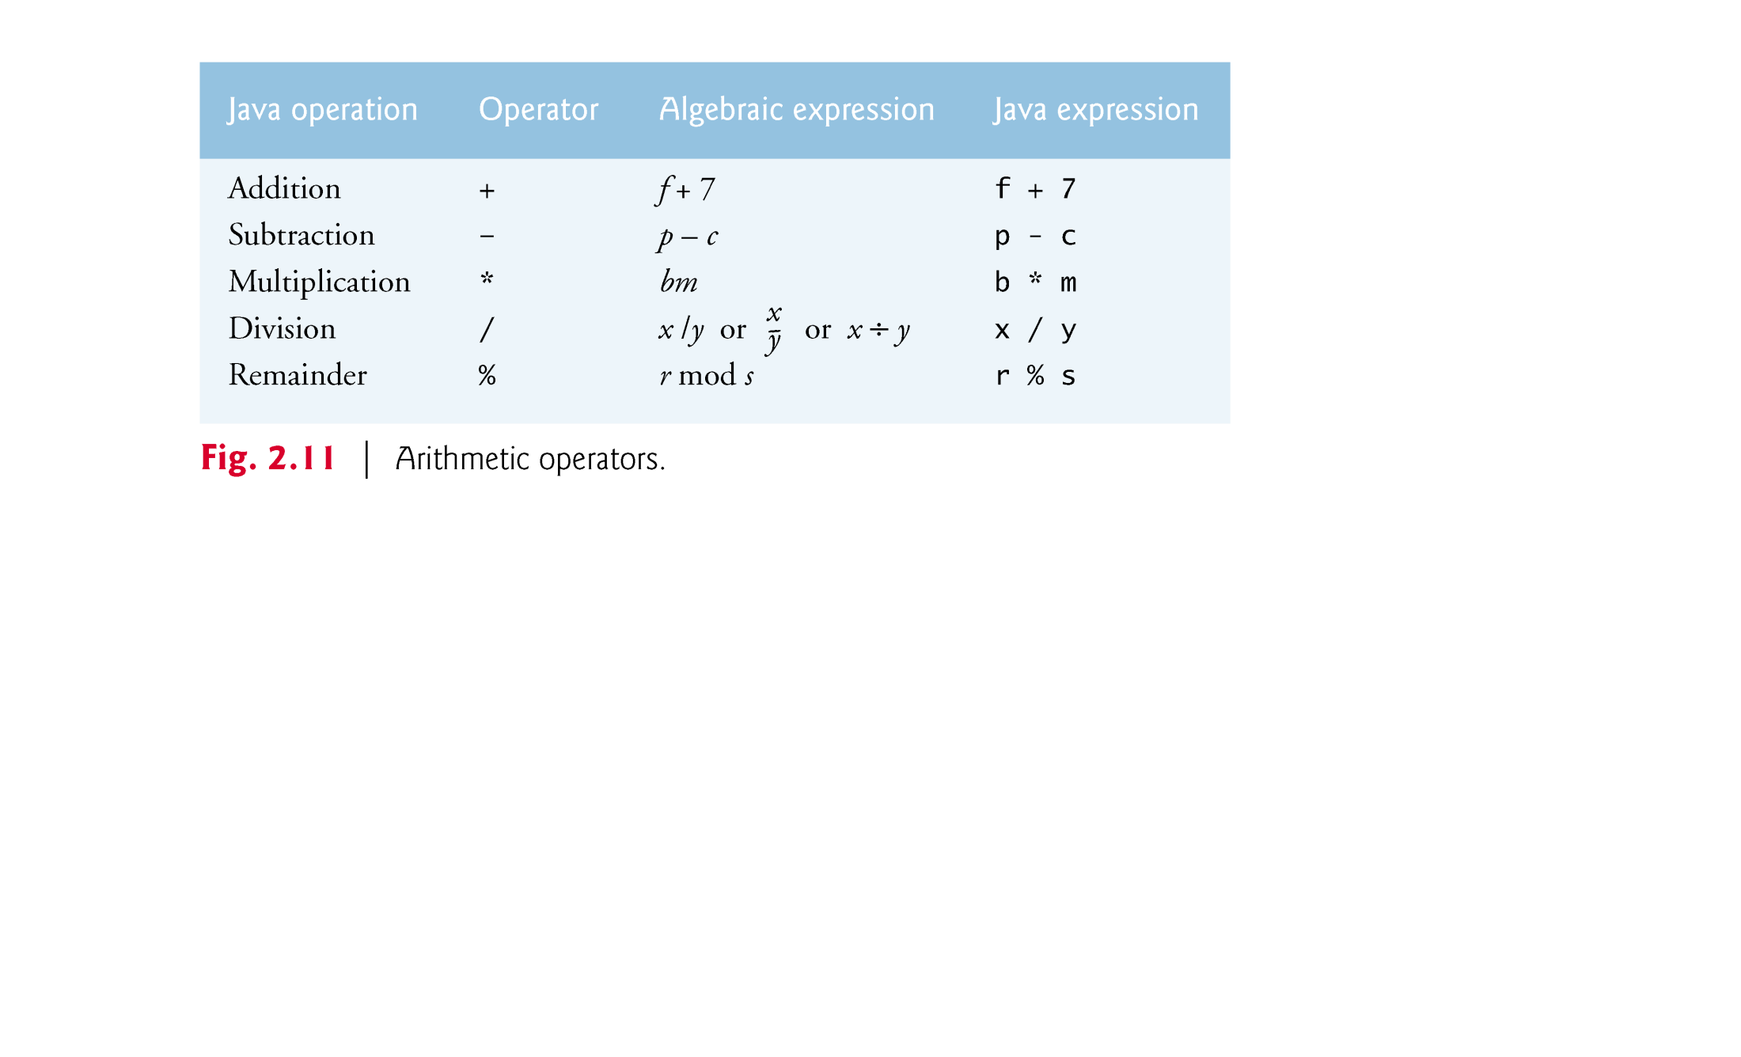
2.7 Arithmetic

Slide 46
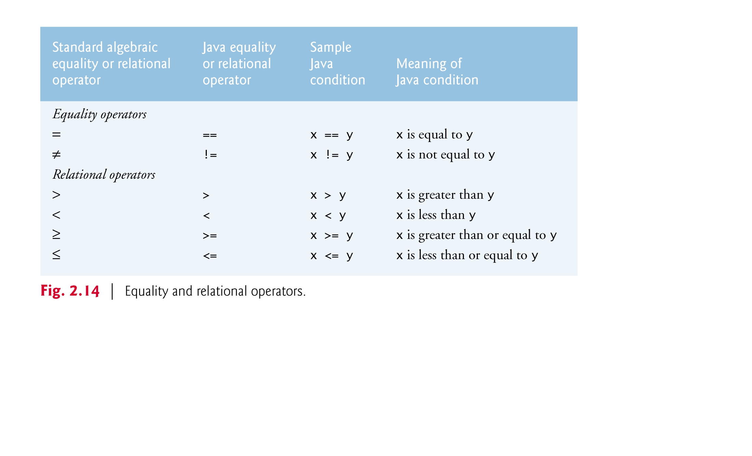
2.8 Decision Making: Equality and Relational Operators

Slide 47
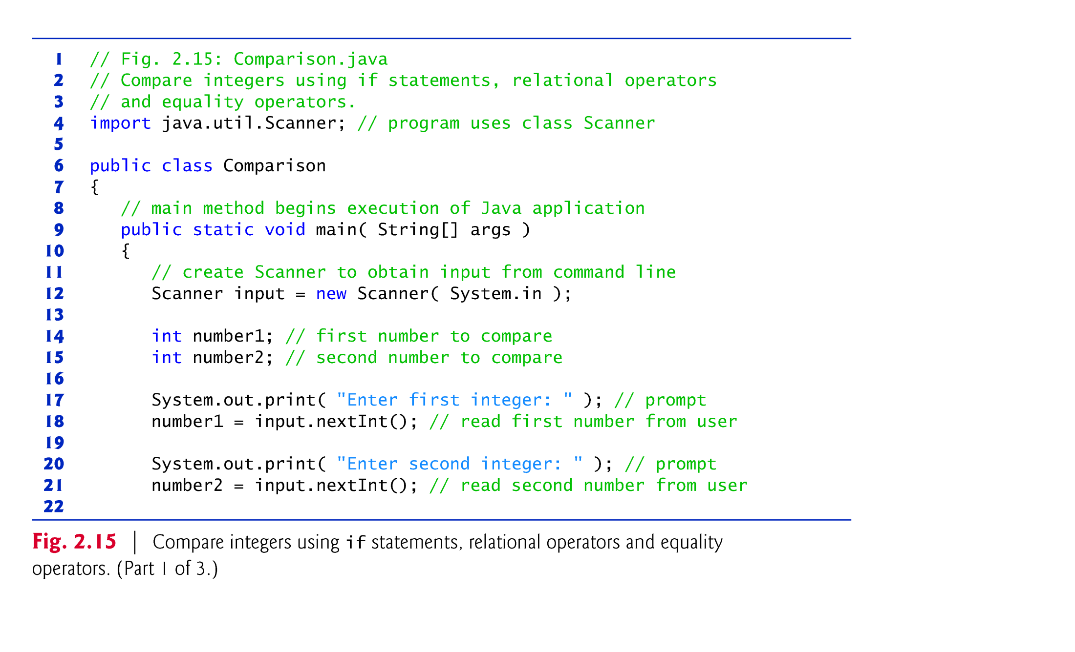

Slide 48
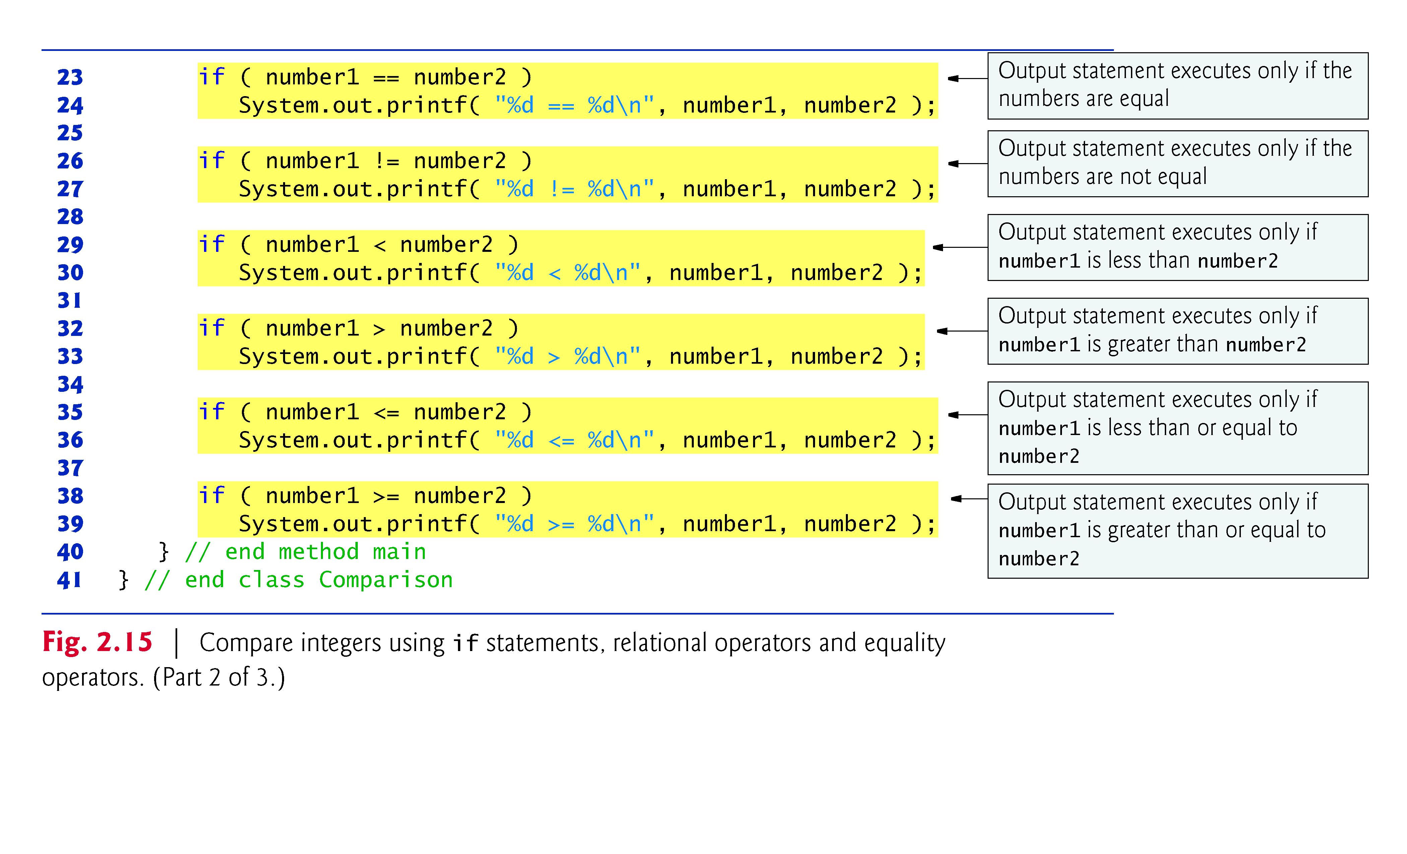

Slide 49
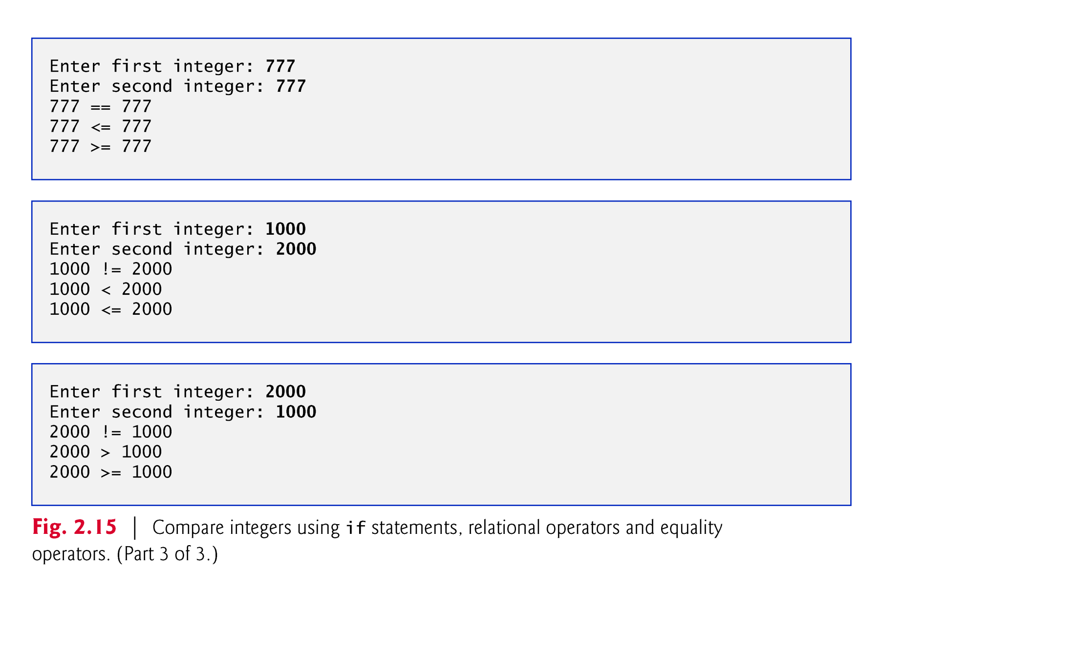

Slide 50
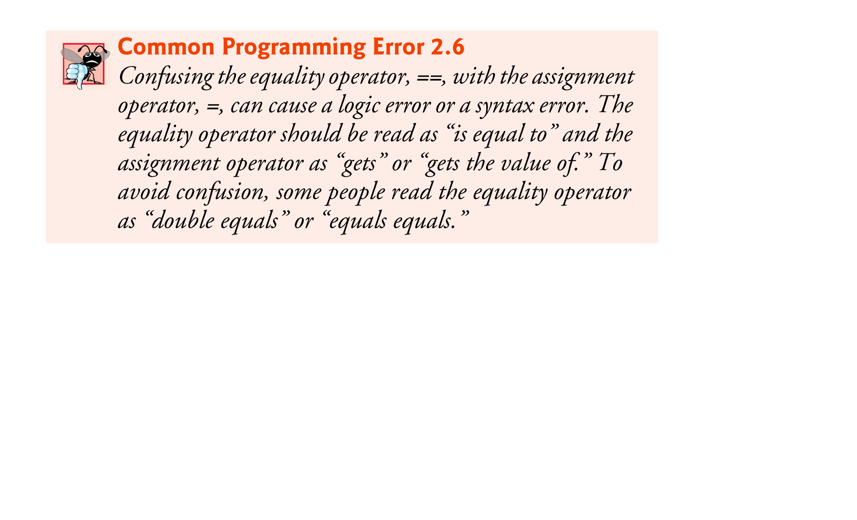

Slide 51
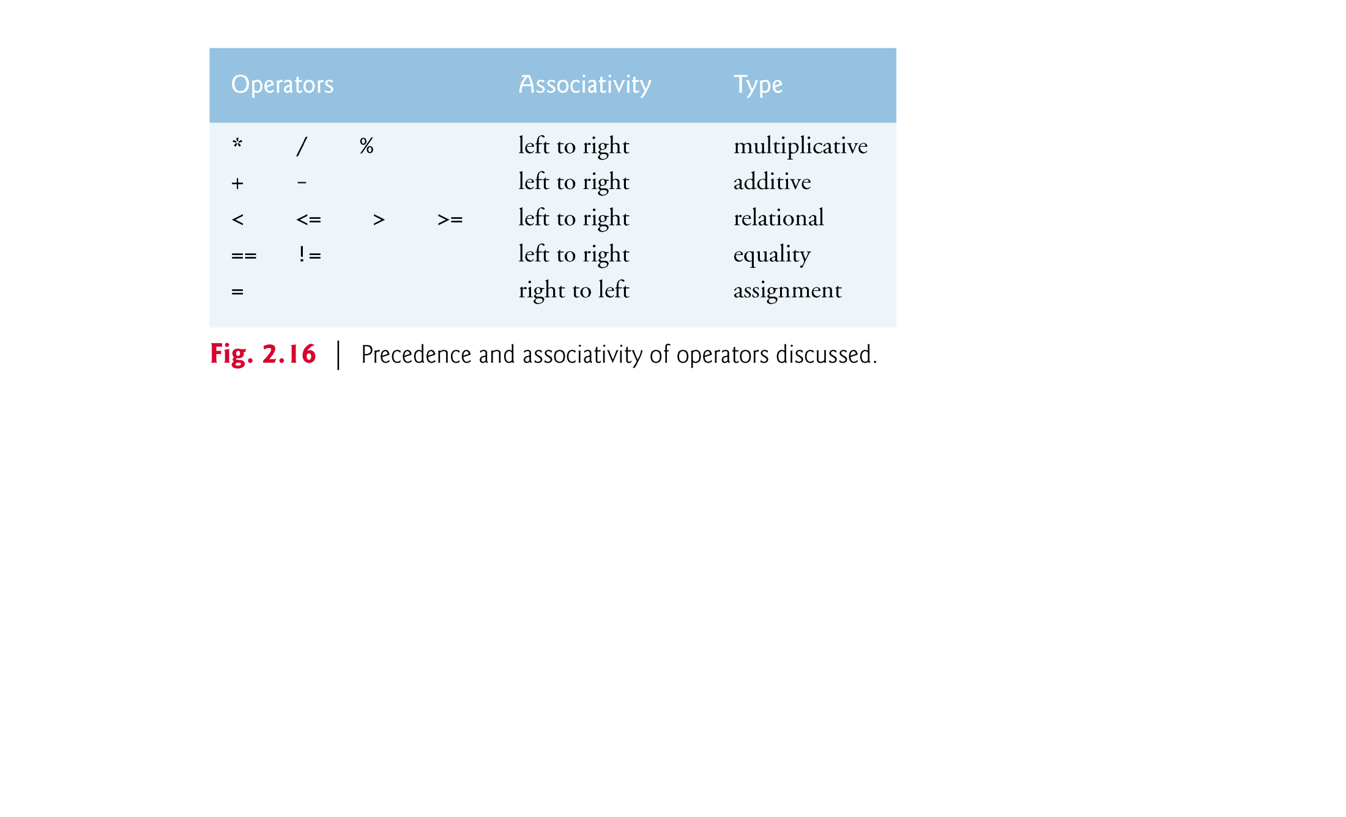

Slide 52
2.9 I/O from the Command Line
A program is often run from the command line and interacts with the user in the command line environment.
Java supports this kind of interaction in two ways:
Standard Streams
The Console

Slide 53
Standard Streams
The Java platform supports three Standard Streams:
Standard Input, accessed through System.in;
Standard Output, accessed through System.out;
Standard Error, accessed through System.err.
System.in is a byte stream
To use Standard Input as a character stream, wrap System.in in InputStreamReader.
InputStreamReader cin = new InputStreamReader(System.in);

Slide 54
The Console
The Console is particularly useful for secure password entry.
The Console object also provides input and output streams that are true character streams, through its reader and writer methods.
Before a program can use the Console, it must attempt to retrieve the Console object by invoking System.console().
Example: Password.java

